Slide 1

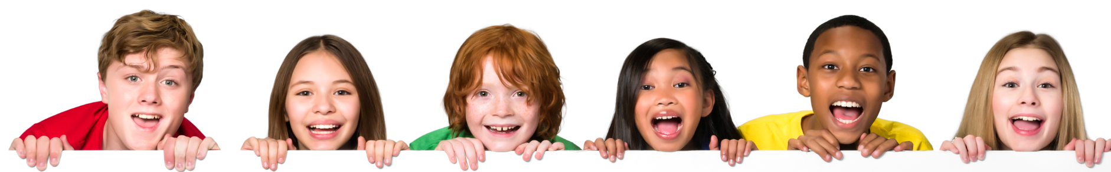

Exploring Engineering
FUN WITH FORCES
Notes:
STEM Session for lower KS2 Year 3 – 4 / P4-5 (age 7 – 9 years old).
Ask teacher to take photos and videos where possible and send them to Ambassador afterwards to share with Amey. Do not take photos of children on your phone.
(1 min) - Welcome to this fun STEM workshop, called Exploring Engineering!
We are going to practice being curious, creative and courageous as you all become mini-engineers and do 2 different experiments to explore how we apply the amazing science you learn in school to real STEM jobs and real problem-solving in our world. Plus you’ll learn a cool engineering magic trick you can take home to show your family and friends!
For the STEM Ambassador – Guide Agenda for the workshop (Total 60 mins)
5 mins – Intro - Brief Intro of role model & Amey (slides 1 – 3)
10 mins - Ice Breaker – Paper bridge activity – Groups of 4 – two bridge designs - Learning point - what are the forces acting on a bridge? How can we engineer a bridge to be stable and strong? (Highlight balancing forces and shapes in design) (slide 4)
10 mins – Learning about Forces - 3 key Forces learning points - Video of Amey bridge build and diverse role models - Discuss examples of different interesting bridge designs with pictures, including bridges for animals - what do they notice about them, what do they think makes them stable and strong? (slides 5 – 7)
20 mins - Main Activity – Can you balance the Beaver’s Bridge! - template, glue stick, bluetack, paperclips, colouring pencils – stick, colour, cut, play, balance, play. (slide 8)
5 mins - Summary –- we need more young people like all of you to be our engineers of the future! (slide 9-10)
10 mins - Q&A & Wrap Up – (optional slide 11) (and give out certificates and mention they can take home their Balancing Beaver to show their families and tell them they have been Exploring Engineering).

Slide 2
WE LOVE STEM!
What is STEM?
People who work in STEM are real life Superheroes!
Through STEM we turn dreams into reality to make the world a better place.
Amey & STEMAZING have collaborated to bring you this STEMAZINGKids session linked to learning about Forces.
Let’s go!
Notes:
(1min) - We love STEM! – Who knows what STEM stands for?
STEM is the combination of Science, Technology, Engineering & Maths and it’s the combination of all these subjects that is super important in our world because everything we rely on in our lives is connected to STEM in some way.
People who work in STEM jobs are real-life Superheroes because they save lives and improve the world around us.
It is using STEM skills, like science, maths, creativity and teamwork that you learn at school, that enables us to turn our ideas and dreams into something real - to create solutions to problems that make the world a better place.
Amey and STEMAZING have collaborated to bring you a super-fun STEMAZINGKids session. Today we are going to focus on a small part of STEM that involves how we make life easier and better for humans by understanding the science of Forces.
Let’s get started!

Slide 3

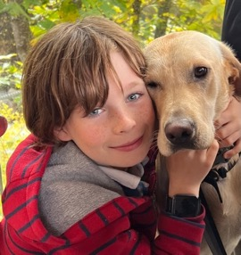
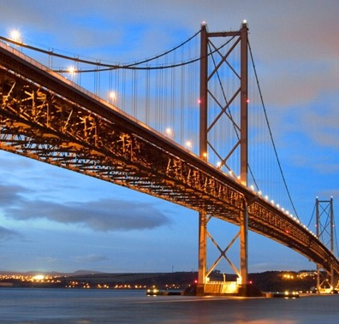
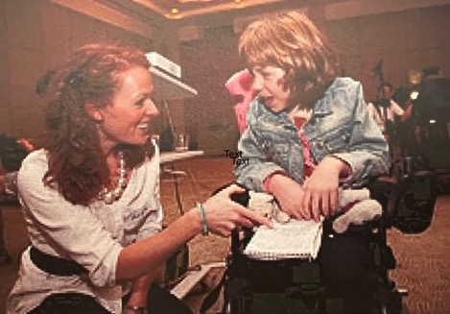
Hi, I’m Alex
My job is – an Engineer
I design things that help people
Fun fact about me – I have worked in Thailand for my job!
Notes:
(2 mins) – (Briefly introduce yourself at the level that an 8-year-old would understand)
E.g. First let me do a quick intro to me - I’m an engineer - Engineers are creative problem-solvers – people often think Engineers always wear a hard hat and work with spanners – I don’t do this! I use my STEM skills to design new things that help improve people’s lives and help make the world a better place. I love being creative and working in teams. I am a mum and also have a dog called Isla. My favourite project was designing a new wheelchair for children with disabilities. Fun fact – I have worked in Thailand for my job!
(We are aiming for Connection before Education – tell them a bit about you as a person, your key characteristics like being curious, creative etc – what do you love about your day job, but also what do you love doing outside of work, do you have children / pets? When you were at Primary School, what did you want to be when you grew up, any fun facts about you that you can share?)
Write your own notes here:

Slide 4


Fun with Forces!
Engineers use an understanding of Forces to help them design and build many things we rely on in our lives – for example, BRIDGES!
Let’s experiment! We are going to work in groups to make and test a simple paper bridge. You will need:
  2 piles of books to make a valley - the cliff (book) edges should be 15cm (a short ruler) apart.
  1 piece of A4 paper & 20 paperclips
We can make something stronger by changing its shape! Maths in action!
Engineers use STEM skills to design bridges to make them stable, strong and sustainable!
Question:
1. What forces act on a bridge?
2. How can we make a bridge stable & strong?
Notes:
(10 min) – Paper bridge activity
People in STEM use science, technology, engineering, maths and creativity to improve the world. One example engineers work on is bridges. Bridges have to be strong and stable. This needs an understanding of forces to design and build them to be safe for people and the planet.
Straight into ice breaker – Paper bridge activity – Groups of 4.
Give out resources – pile of books, 15cm ruler (teacher), 1-piece A4 paper and 20 paperclips per group. Then talk them through the steps below:
Make the valley that your bridge is going to span (cliff book edges 15cm apart – length of short ruler)
Fold paper in half like making a card and carefully balance it over the books to span the valley. This is called a Beam Bridge – just a flat bridge.
Carefully – taking it in turns as a team – add one paperclip at a time to see how strong your bridge is. We are testing to destruction which is something we sometimes do in engineering to help us understand the limits of something we have designed! When you bridge collapses that is how strong it is – how many paperclips did yours take before it collapsed?
Now take the same piece of paper and carefully fold the long edge sides up to make it like a half box shape – this is called a Girder Bridge.
Balance this over the valley again and take it in turns to load paperclips one at a time – How many can this design of bridge take? (They may need to find other things to load with such as pencils, rubbers etc)
Isn’t that amazing – we haven’t changed the material or thickness of the bridge – it is still just a single piece of paper, but by changing its shape very slightly we improved its strength significantly so it could withstand a lot more force. This is MATHS IN ACTION as you learn about shapes in maths and different shapes have different properties that we use in engineering design.
Discussion
What are the forces acting on a bridge?
Weight due to the force of gravity – the bridge’s self weight, weight of anything on the bridge like people, vehicles, even snow! Plus forces due to other things like wind.
How can we engineer a bridge to be stable and strong?
Just like you have done today – we can engineer the bridge design by choosing a shape that is strong – like a girder shape. Connected triangles are also very strong shapes. That’s called a Truss. We can also choose strong materials – so in real life we don’t make bridges from paper! We make them from concrete, steel, stone and other strong materials. We also have to ensure the forces are balanced so the bridge is stable and doesn’t topple over!
Key STEM message - We can use maths in engineering design to make things safe and strong. Engineers use different shapes when designing and building things, like bridges, to resist forces that want to break them. You learn about different shapes in Maths. In real life engineering we can use different shapes in the things we design to create the outcome we need. Like making something light or flexible or strong. We can make something stronger by changing its shape.

Slide 5
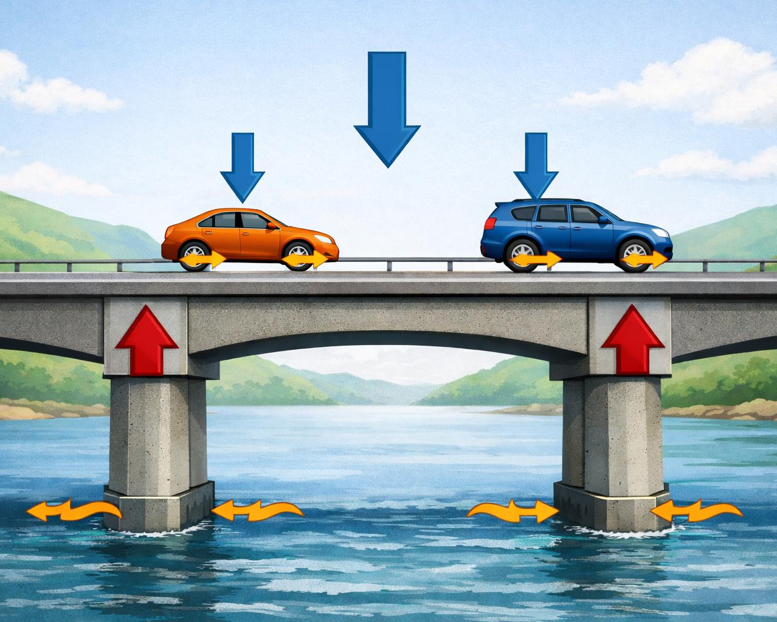
What can you tell me about Forces?
Gravity
Gravity is the force that pulls objects down towards Earth (this gives objects weight). This is a non-contact force because it acts without touching (magnetism is also a non-contact force)
Contact Forces
Contact Forces need objects to touch. For example - air resistance and friction. They can only apply a force onto an object if they touch it directly.
Balancing Forces
For an object to stay still – the forces acting on it need to be balanced. An object will move if its forces are unbalanced.
Notes:
(4 mins) - (Before you click to reveal the 3 key learning points) – Say we have mentioned Forces a few times already – What can you tell me about Forces?
3 learning points from KS2 curriculum on Forces
Gravity is the force that pulls objects down towards Earth (this gives objects weight). This is a non-contact force because it acts without touching the object - gravity acts something even when nothing else is touching it – like a ball falling through the air (magnetism is also a non-contact force). Can the children show you the forces due to gravity in the picture? The blue arrows pointing down are due to gravity acting on the bridge and the cars.
Contact Forces need objects to touch. For example - air resistance and friction. Can the children show you the Contact Forces from Friction and Water in this image?
Balancing Forces -For an an object to stay still – the forces acting on it need to be balanced. An object will move if its forces are unbalanced. This bridge is balanced because the force pushing up from the bridge columns are resisting the forces acting downwards, so it doesn’t collapse. Also the forces are balanced over the bridge so it doesn’t topple sideways.
To bring this to life we have a video of real examples of bridges we have worked on in Amey.

Slide 6

Magic with magnets!
Amey bridge video 1.5 min
Notes:
(3 min)
1.5 min video - Real life examples of bridges we have worked on in Amey
1.5 mins Quick Fire - Why are bridges are important! Why do we need them? Quickly shout out reasons in the classroom! Hands up!
Bridges are important because they help us get from one place to another! They let us cross rivers and canyons easily and safely. Sometimes they can span entire valleys!
Here are some reasons why bridges are important:
Connecting places: Bridges connect towns, cities, and even countries. They help people travel and trade with each other.
Making travel easier: Bridges make it faster and easier to get where we need to go. Instead of taking a long detour, we can just cross the bridge. And it’s not just people and cars, there’s animal bridges, railway bridges and waterway bridges!
Helping with trade: Bridges help transport goods and products from one place to another. This is important for businesses and the economy.
They can be made of lots of different materials including steel, stone, wood, and even ropes and vines!
VIDEO

Slide 7
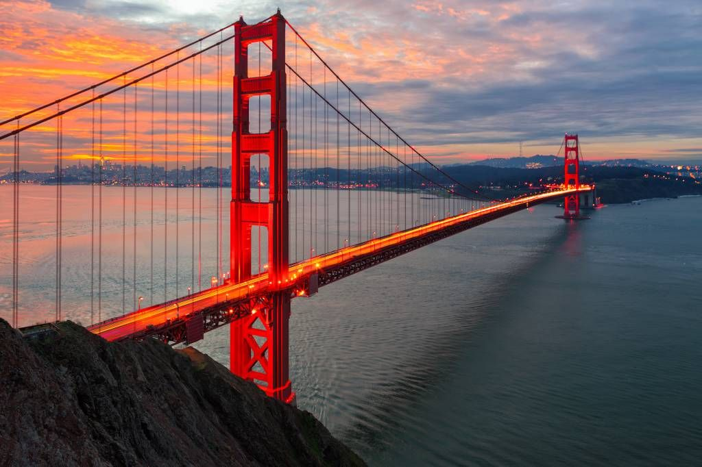
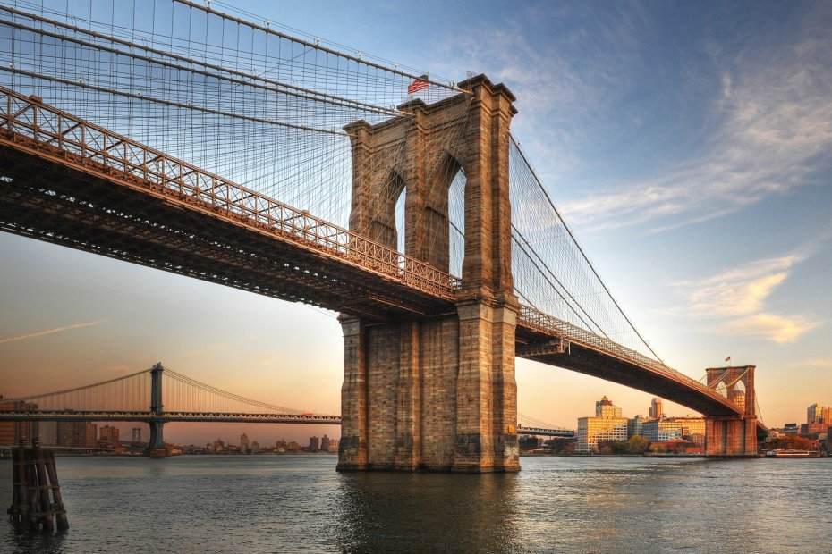
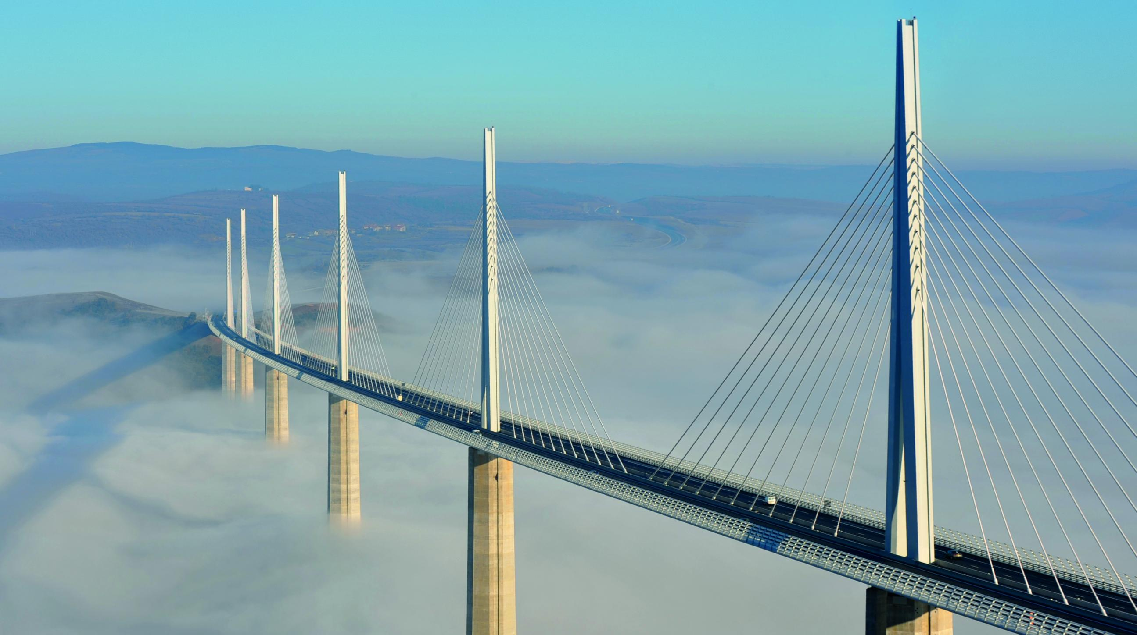
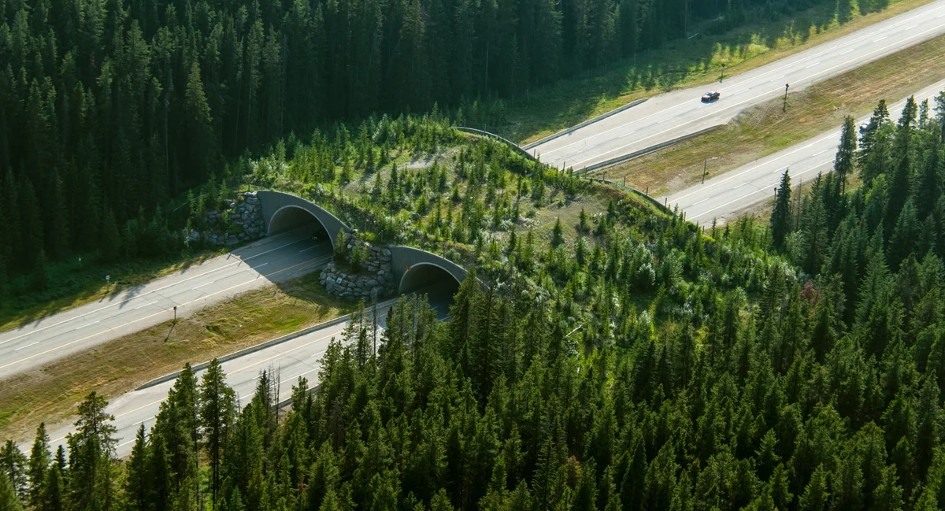
Notes:
(3 mins) – QUICK EXAMPLES - Some other real-life bridges? Can you name any of these or other ones you know? Hands-up!
• Golden Gate Bridge (USA): In San Francisco, this bridge is famous as it is bright red and seen in lots of films! This bridge is so long that if you stretched out all its steel wires, they would wrap around the Earth more than three times!
• Brooklyn Bridge (USA): In New York City, the Brooklyn Bridge was built over 140 years ago. People were so scared to cross it that an elephant parade was used to prove it was safe! This bridge build was actually led by a female engineer Emily Roebling, after her husband became so ill that she took over completing it - but because women weren’t allowed to be engineers back then, she had to keep this a secret and didn’t get the credit she deserved until many years later.
• Millau Viaduct (France): In southern France, the Millau Viaduct is so tall it’s higher than the Eiffel Tower and sometimes looks like it’s floating above the clouds.
• wildlife bridge (found all over the world): Wildlife bridges exist in countries like Canada, the Netherlands, and the UK, and they are special bridges just for animals so they can safely cross roads without cars. So not all bridges are built for cars and people!

Slide 8
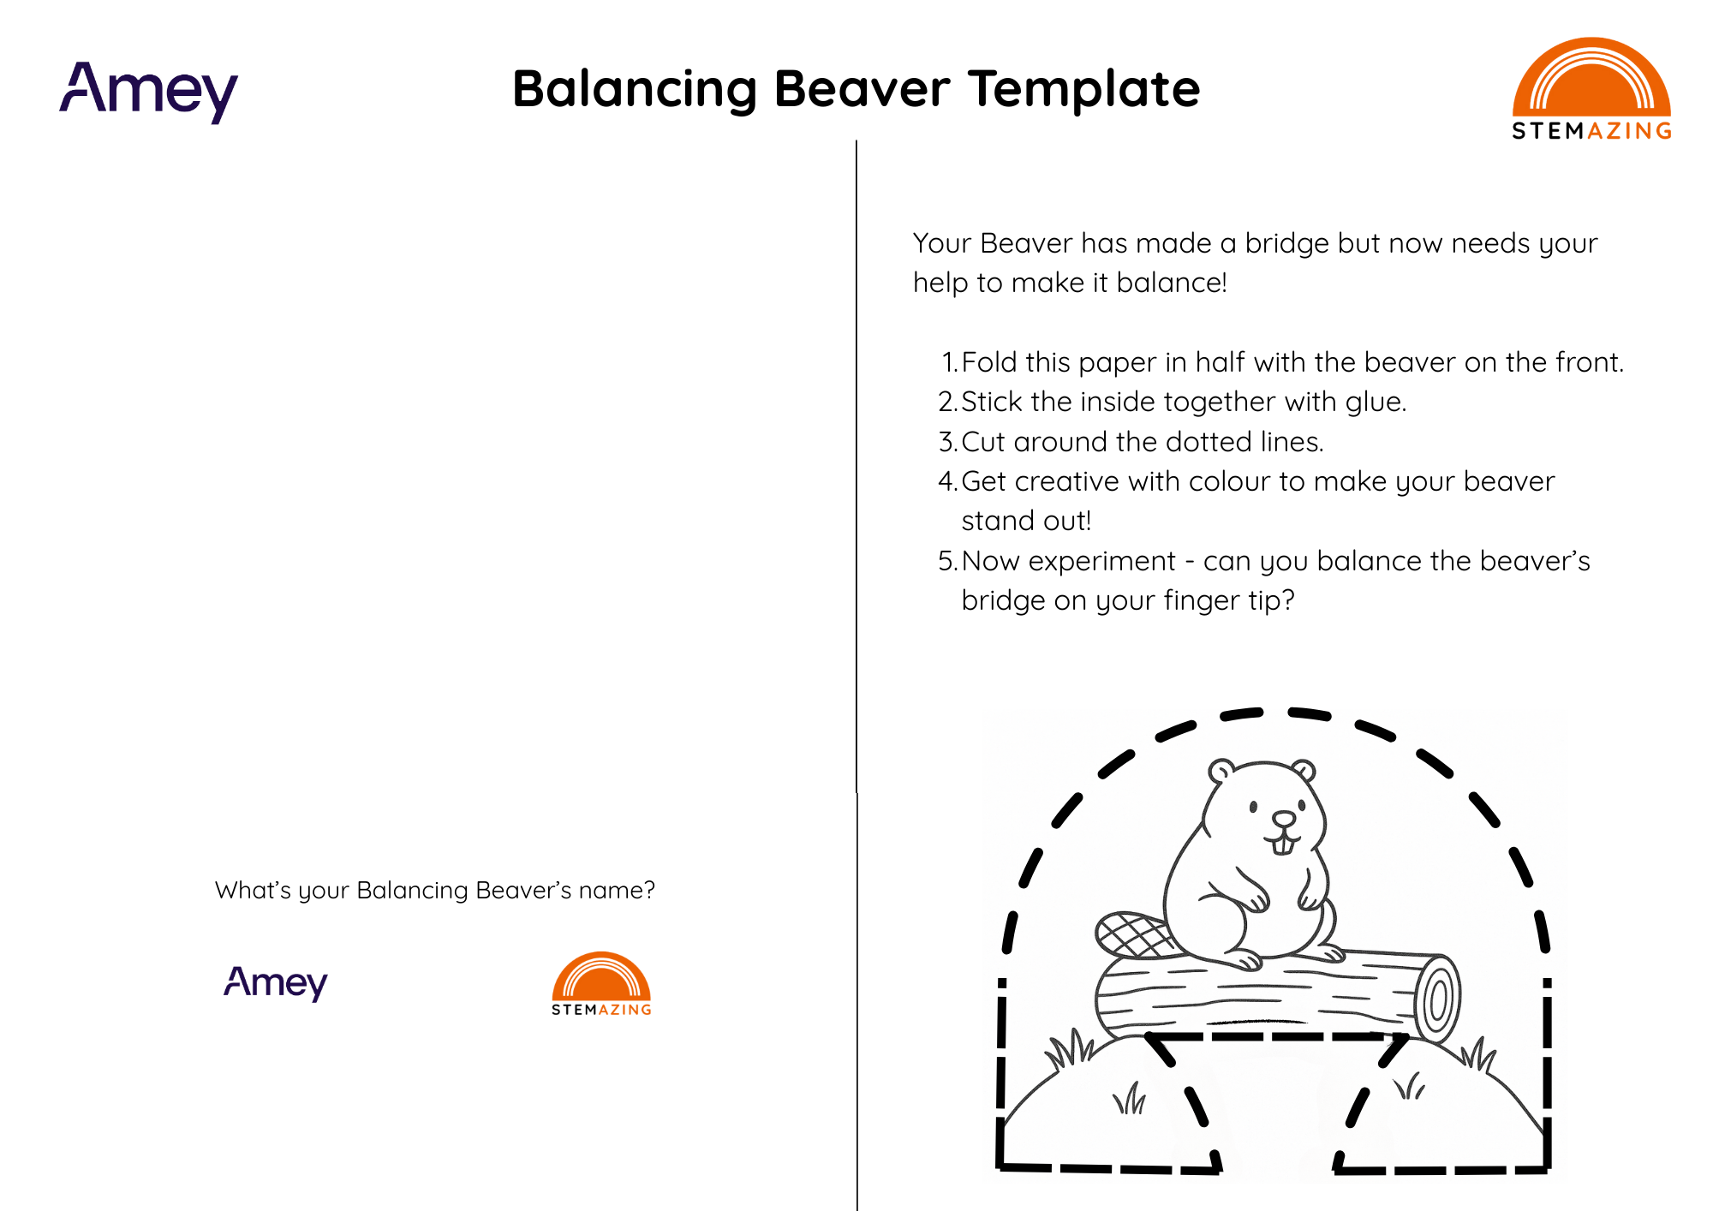
Can you Balance your Beaver’s Bridge?
Now it’s your turn to do another brilliant bridge challenge!
This little Beaver has built a bridge but needs your help to make it balance!
Let’s all be STEM Superheroes and save the day!
  You will need:
  Beaver template
  Glue stick
  Scissors
  Colouring pencils
  Pea-sized blob of blue tack
  2 paperclips
Notes:
(20 min) – main activity – each child makes their own
Your Beaver has made a bridge but now needs your help to make it balance!
Fold this paper in half with the beaver on the front.
Stick the inside together with glue.
Cut around the dotted lines.
Get creative with colour to make your beaver stand out!
Now experiment - can you balance the beaver’s bridge on your fingertip?
They won’t be able to make it balance as it is too top-heavy.
We need to modify the design to make it more stable – we have to add additional and equal weight on each side at the bottom to give the bridge stronger foundations and make it balanced
Split the pea-sized blob of bluetack in half – roll each one to make a short worm shape.
Stick a worm on the back at the very bottom on each side of the template. Then stick a paperclip to each of those for additional weight.
Now try balancing on your fingertip again!
Where else can you balance it? Play with it. Can you balance it on your nose? On your ruler? On your pencil tip?
Some children may know – we are “lowering the centre of mass” or Centre of Gravity (C of G) of the object to make it more stable. This is a common thing engineers consider when building structures to make them stable and balance, especially in places where lots of forces could topple them over – like earthquake zones!

Slide 9

Questions for you!
What does STEM stand for?
  Science Technology Engineering & Maths.
What Force gives something weight?
  Gravity.
How do you make something stable?
  Balance the forces (and lower the centre of mass).
How do engineers improve the world?
  They use STEM skills to design and build solutions that solve problems.
Hands up if the answer is YES to these questions:
Did you enjoy the workshop today?
Do you know more about how STEM makes a difference in the world?
Are you interested to learn more about STEM jobs in future?
Notes:
(4 mins summary questions)
What does STEM stand for?
Science Technology Engineering & Maths.
What Force gives something weight?
Gravity.
How do you make something stable?
Balance the forces.
How do engineers improve the world?
They use STEM skills to design and build solutions that solve problems.
PLEASE TRY TO MAKE A NOTE OF THE % CHILDREN THAT ANSWER YES WITH HANDS UP TO THESE QUESTIONS TO ADD IT TO YOUR POST ENGAGEMENT FEEDBACK FORM. WE WANT HONEST IMPACT DATA FOR OUR OVERALL IMPACT ASSESSMENT – THE RESULTS WILL NOT BE LINKED TO YOU PERSONALLY.
Hands up if the answer is YES to these questions:
Did you enjoy the workshop today?
Do you know more about how STEM makes a difference in the world?
Are you interested to learn more about STEM jobs in future?

Slide 10

What will your future look like?
There are endless possibilities in a STEM career.
We need more young people like you to become our future real-life STEM superheroes.
Thank you and well done -
YOU ARE STEMAZING!
Notes:
(1 min wrap up) - So you could all work in STEM careers in future if you wanted to and help make the world a better place for people and the planet. Thank you and well done - You have all been STEMAZING!
Remind the children to tell their families about what they have learnt today and see if they can keep being mini engineers and STEM Superheroes at home by being Curious, Creative and Courageous and keep playing with what else they can design and balance to keep exploring forces!
You all get a certificate - (some teachers may prefer to send home electronic certificates rather than printed ones so please ask the teacher in advance). Children can take their Balancing Beavers home.
Final additional 10 mins for questions – Q&A and tidy up and give out certificates

Slide 11
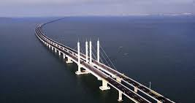
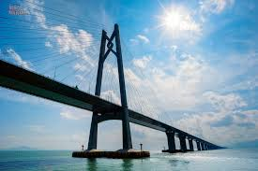
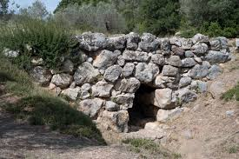
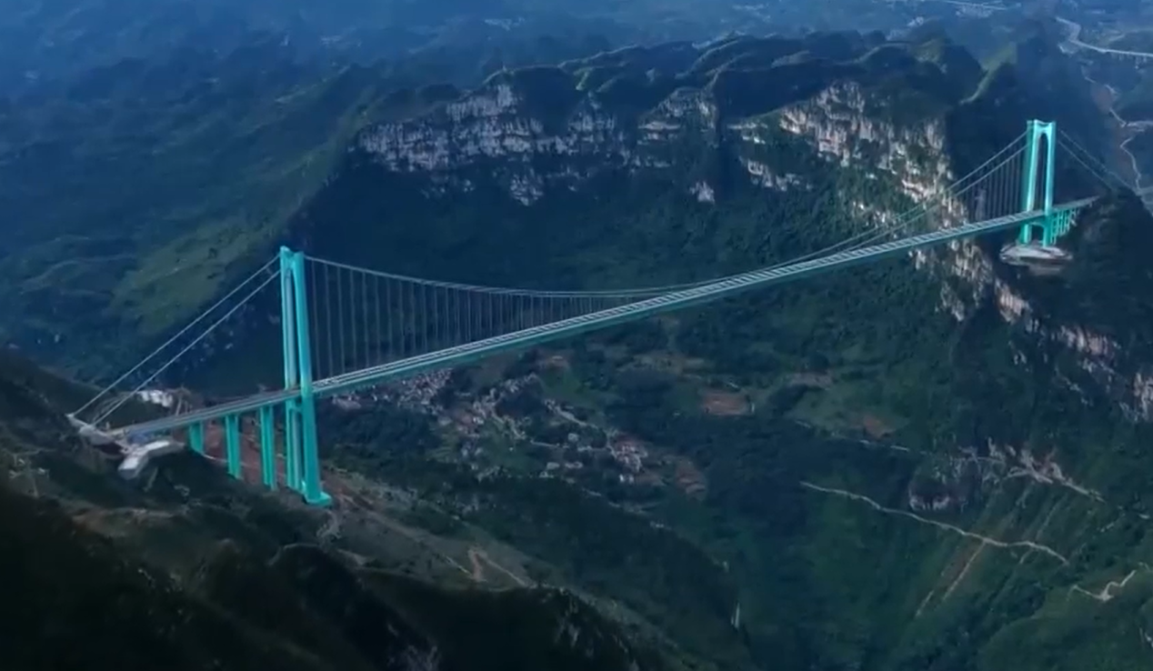
Most Expensive
Longest
Oldest
still in use
Tallest
Notes:
Optional Extra info for questions for Role Model if needed – What is the ?? Bridge in the World right now?
Longest: The Danyang–Kunshan Grand Bridge in China is a 164.8-kilometre-long (102.4 mi) viaduct on the Beijing–Shanghai High-Speed Railway. It is the longest bridge in the world.
Oldest: The Arkadiko Bridge (also known as the Kazarma Bridge) in Argolis, Greece, is considered one of the oldest crossable arch bridges still in existence, dating back to the Mycenaean period around 1300 BCE (over 3000 years old!). Though humanity will have been using bridges for far longer, using falling trees or making bridges out of natural (perishable) materials.
Most expensive: The most expensive bridge in the world is the Hong Kong-Zhuhai-Macau Bridge (HZMB), costing an estimated $20 billion to build!
Tallest: Huajiang Grand Canyon Bridge, in China measuring 625 meters from the deck to the ground below. It opened in September 2025 and cut the journey time from 2 hours to 1 minute!

